Slide 1
Create tiled map using Global map
Taro Matsuzawa
Georepublic Japan

Slide 2
Topics
Introduction of web map and tiled map
Introduction of software and global map
Create tiles from vector files
Create tiles from raster files
Create web map application with created tiles
Introduction of Vector tiles and other

Slide 3
Web map
“Web map” is…
Clickable map
Georeferenced map images
Tiled web map

Slide 4
Clickable Map
Pattern 1: Using HTML ‘map’ and ‘area’ tag
Many rails and bus route map
Old style (from Netscape Navigator 2.0)
Pattern 2: HTML5
Country map
Modern style
Using canvas or CSS function

Slide 5
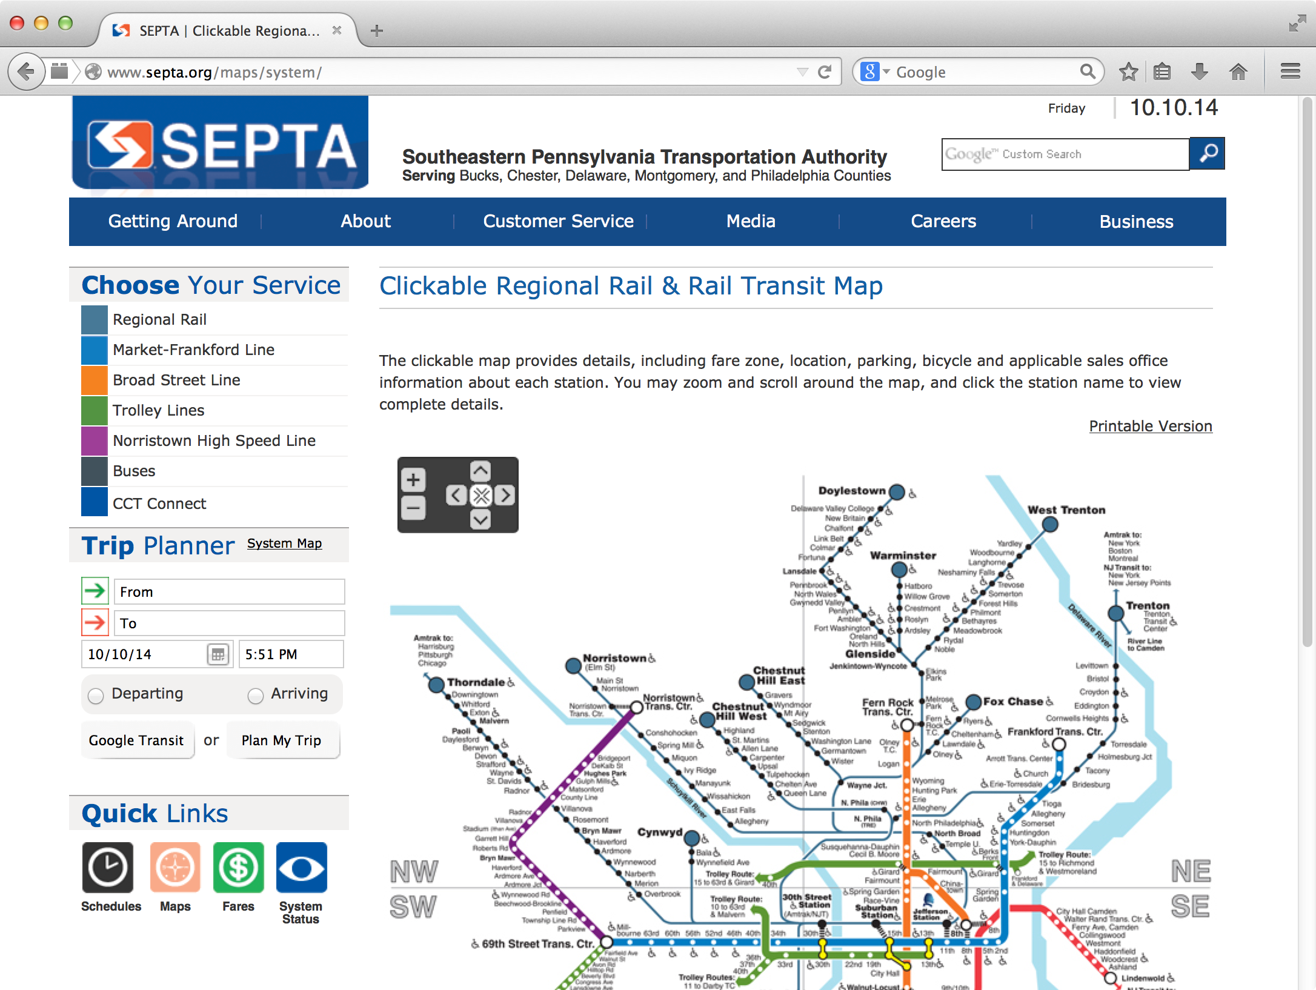
Rails Map example
http://www.septa.org/maps/system/

Slide 6
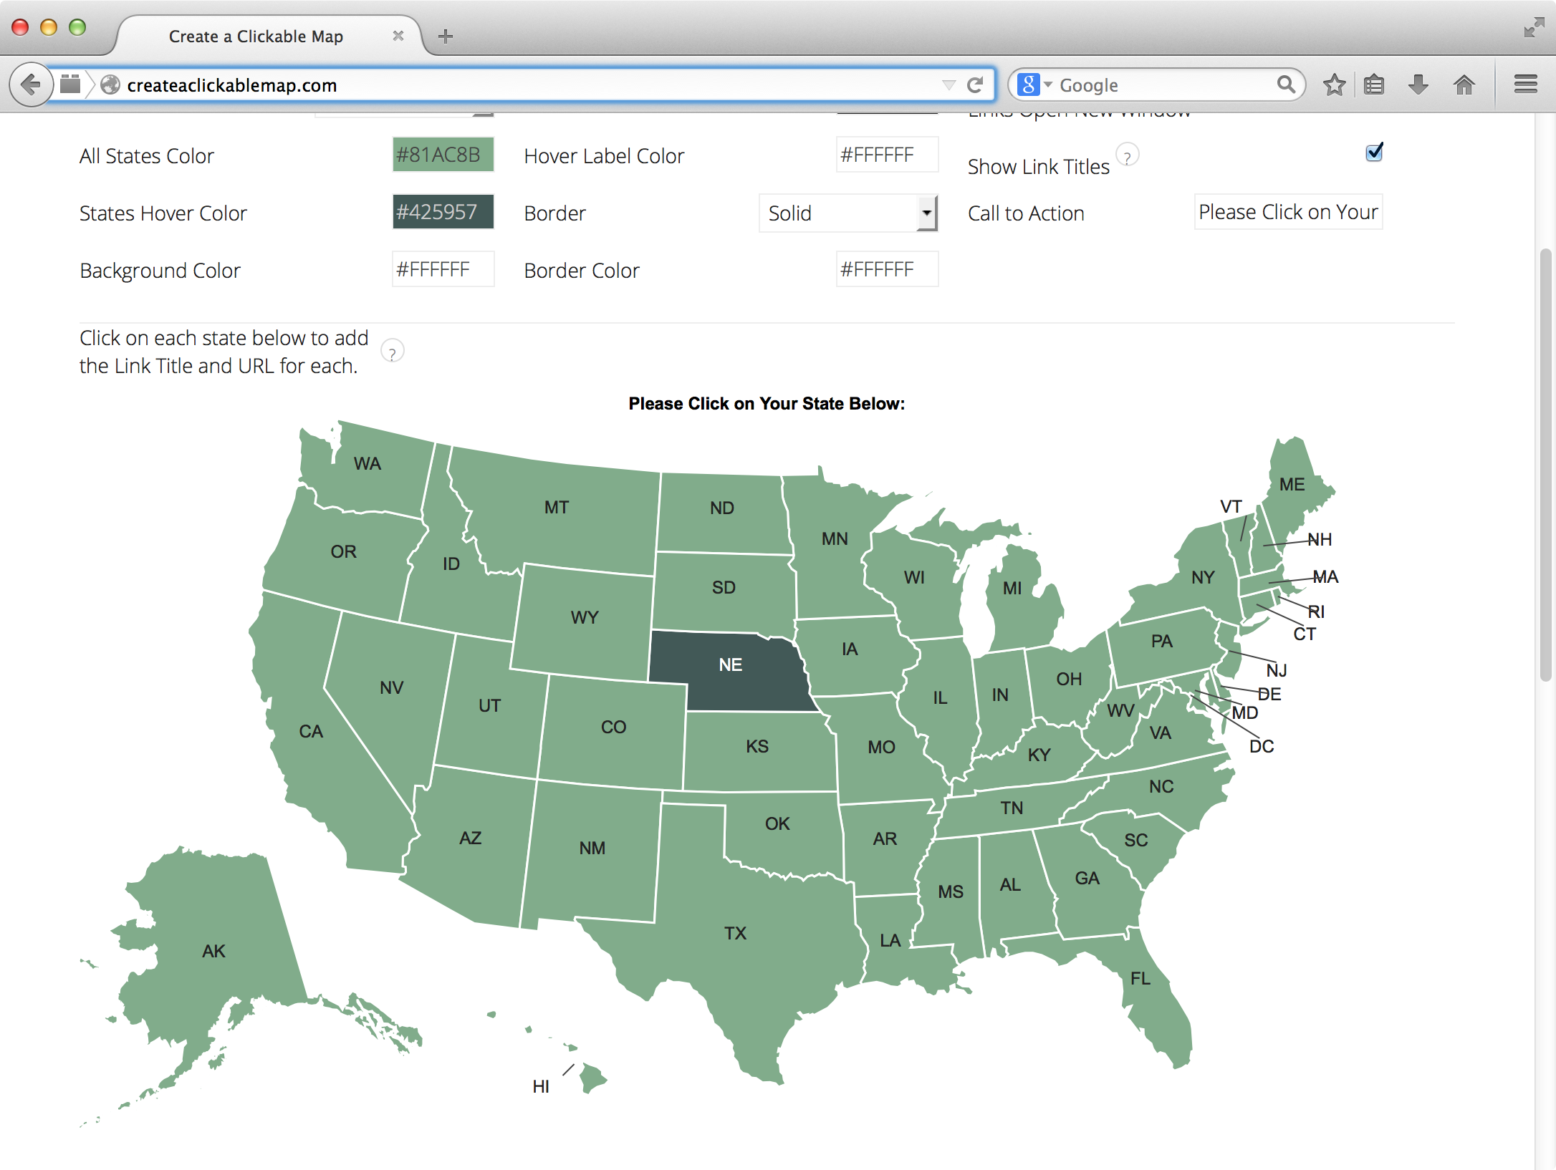
Country Map
http://createaclickablemap.com/

Slide 7
Georeferenced map images
Server create images by response using data from GIS databases or other storage.
Server side software may process request include bounding box and etc.
Web Map Service (WMS) Protocol is famous.

Slide 8

Tiled web map
Provide map images over the internet.
Map images are separated as tile.
Zoom Level 0 = World
Each zoom level doubles in both dimensions
Too many tiles use “Web Mercator projection”
http://a.tile.openstreetmap.org/0/0/0.png

Slide 9
Tile
Tile images are “static contents”.
Tile images can provide with static web server.
Also you can use in local machine with file URL schema (file:///).

Slide 10
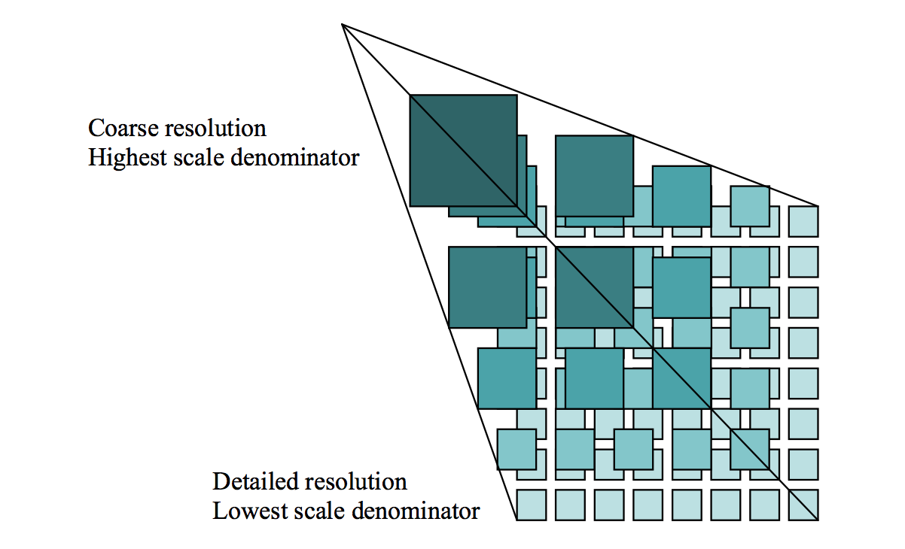
Zoom
Zoom level 0 : 1 file
Zoom level 1 : 2 x 2 = 4 files
Zoom level 2 : 4 x 4 = 16 files
…
Zoom level 18 262,144 x 262,144 = 68,719,476,736 files

Slide 11
Request
Many service use REST API (GET).
http://…/Z/X/Y.Format
Z = Zoom Level
X = X coordinate
Y = Y coordinate
Format = Image file format (PNG, JPEG)

Slide 12
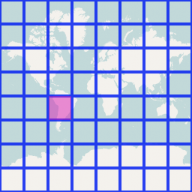
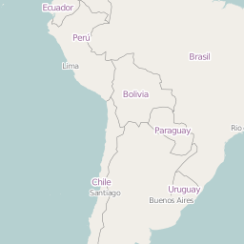
Request example
http://a.tile.openstreetmap.org/3/2/4.png
Zoom=3, X=2, Y=4, format=PNG
X and Y coordinates start with 0.

Slide 13

Web Mercator
Cut off coverage at 85.051129° north and south.
EPSG:3857
Famous as “OpenLayers:900913” (Google)
85.051129°
-85.051129°

Slide 14
Tile Service Specification
Two tile service specification
Tile Map Service (TMS)
Web Map Tile Service (WMTS)
TMS’s X Y coordinate is started from bottom left.
It’s difficult to use because X Y coordinate in computer is started from top left.

Slide 15
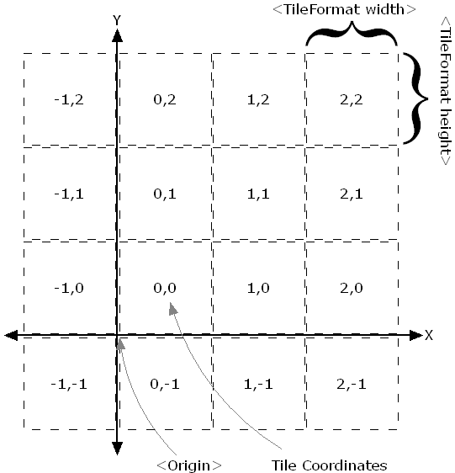
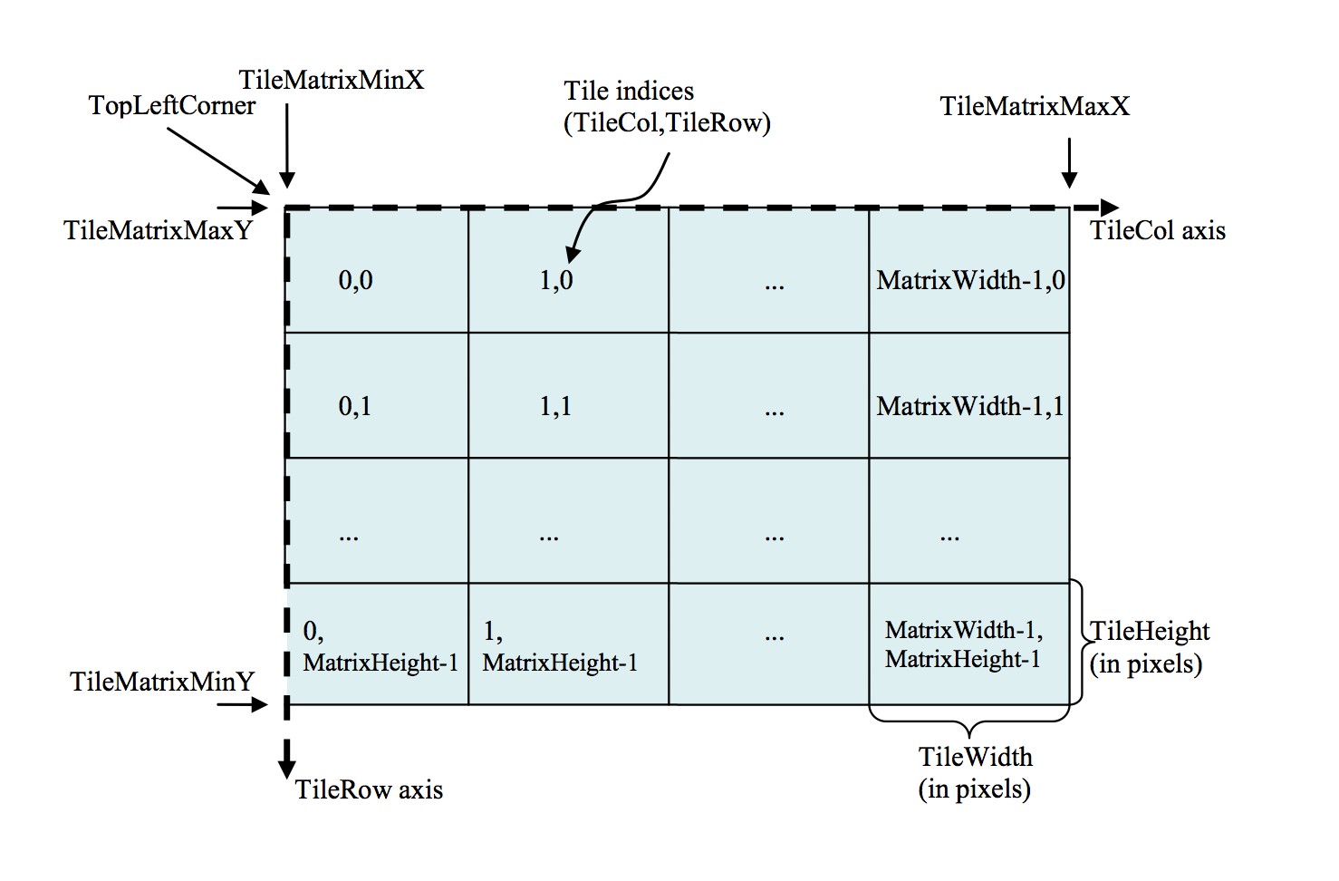
TMS vs WMTS

Slide 16
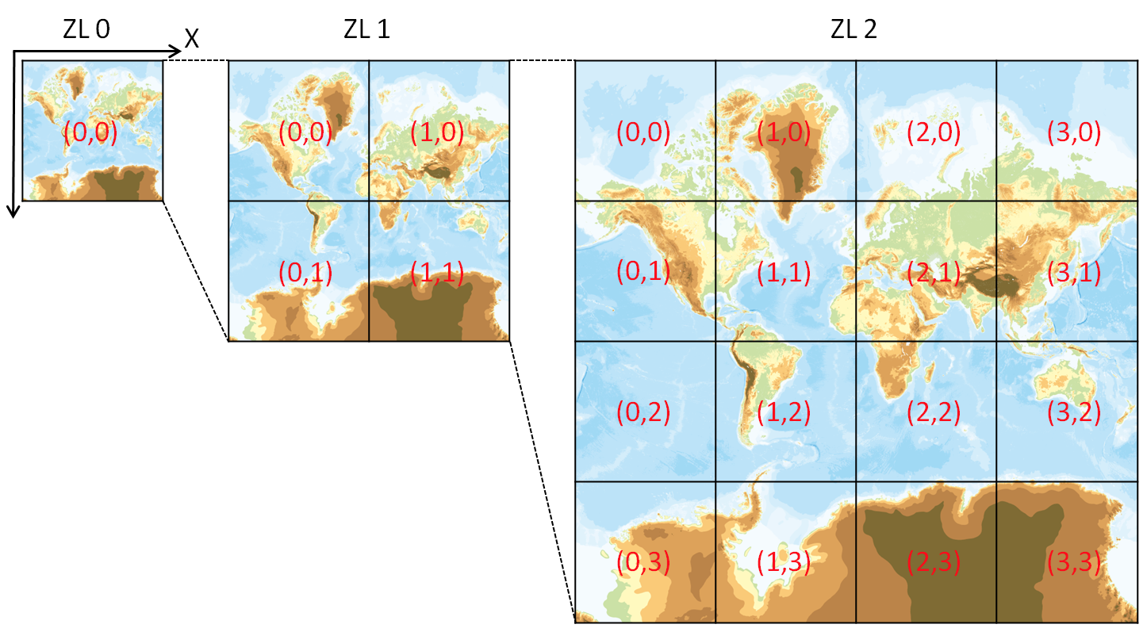
The Y coordinate flipped
OpenStreetMap use TMS like protocol but The Y coordinates are numbered from top left.
If take no thought of meta data, Y coordinate flipped TMS equals WMTS.
GSI Map use this rule too.
We call zxy tile
{z}/{x}/{y}.png
Also call xyz tile
http://portal.cyberjapan.jp/help/development/siyou.html

Slide 17
ZXY tile
De facto standard of tile.
Web Mercator
Y coordinate flipped TMS
Provide REST API
{z}/{x}/{y}.{format}
Anyone provide “Specification”

Slide 18
JavaScript Libraries for display map
OpenLayers
Full stack library for web map
Support many formats
Include drawing function and others
Leaflet.js
Simple implementation
Extend with plugins
Small footprint
Mapbox GL JS
Require OpenGL
Supports raster tile and vector tile.

Slide 19
Leaflet example
<body> <div id="map"> <script> var map = L.map('map'); L.tileLayer('http://cyberjapandata.gsi.go.jp/xyz/std/{z}/{x}/{y}.png', {
attribution: "<a href='http://portal.cyberjapan.jp/
help/termsofuse.html' target='_blank'>国土地理院</a>" }).addTo(map); map.setView([35.3622222, 138.7313889], 5);
</script>
http://portal.cyberjapan.jp/help/development/sample.html#sample-ll

Slide 20
Libraries for Smartphone
Mapbox iOS SDK / Mapbox Android SDK
using C++ and OpenGL
Supports vector tile
OSMDroid
Android Library
Leaflet / OpenLayers / Mapbox GL JS
Use JavaScript Library in WebView.

Slide 21
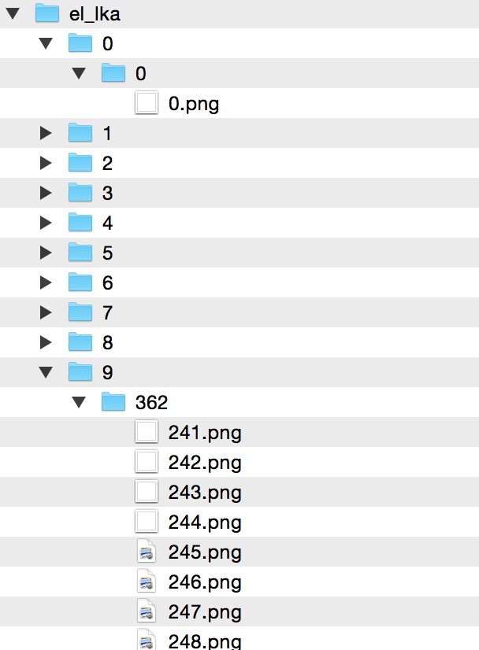
Other format: MBTiles
MBTiles is container of tile
MBTiles is single Database (SQLite)
Tilemill can output MBTiles
TMS schema (not zxy)
Ｘ | Ｙ | Ｚ | blob
0 | 0 | 0 | (binary)
… | … | … | …
241 | 362 | 9 | (binary)

Slide 22
Work Shop: creating tiled map using Global MaP

Slide 23
The Goal for this workshop
Create “your country” tiled map using Global Map.
Customize map design.
Create simple web site.

Slide 24
Steps for this workshop
Make sense about Software and Global Map.
Download Global Map.
Design map and generate tiled map from vector files.
Design map and generate tiled map from raster files.
Create simple web site.

Slide 25
OS / Software
OS: OSGeo-Live 10.0 or Windows 7
GDAL/OGR
QGIS
Tilemill (or TileOven)
Mapnik
Carto / CartoCSS
Leaflet.js

Slide 26
OSGeoLive 10.0
OSGeo-Live is Linux distribution includes too many open source geospatial software.
Easy to try too many software.
OSGeo-Live 10.0 is based on Lubuntu 16.04 (Ubuntu 16.04).
http://live.osgeo.org/en/index.html
This presentation targets OSGeo-Live 10.0 and Windows 7 64bit with OSGeo4W.
Also you can try in Ubuntu 16.04 .

Slide 27
GDAL/OGR
http://gdal.org/
GDAL/OGR is translator library for raster and vector geospatial data formats.
GDAL: for raster files
OGR: for vector files
Also include command line tools.
ogr2ogr: convert vector format
Using convert files in this workshop.

Slide 28
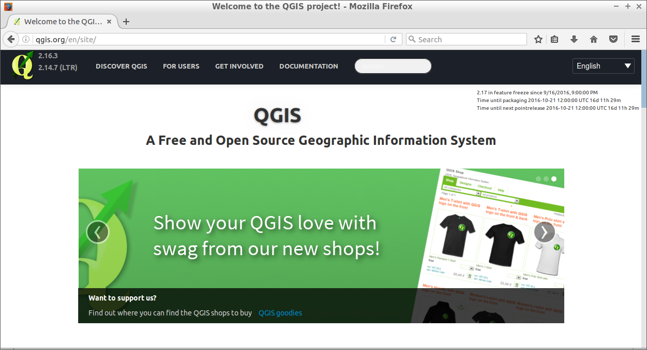
QGIS
Open Source Geographic Information System
Some GDAL/OGR utilities can run from QGIS.
﻿http://www.qgis.org

Slide 29
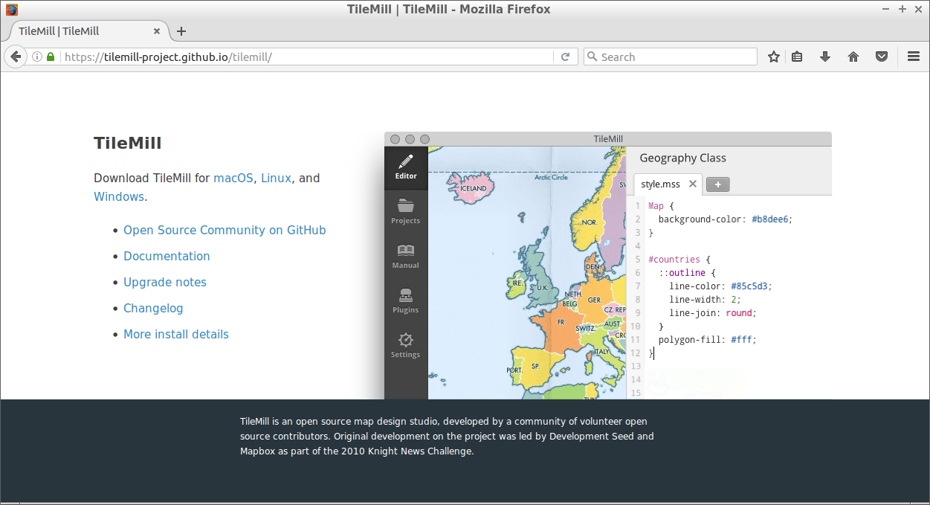
Tilemill
Open source design map tool.
https://tilemill-project.github.io/tilemill/

Slide 30
Notice
Tilemill supports Windows, macOS, and Linux but Tilemill is not support recent Ubuntu.
If you use Ubuntu 15.04 over, need to use TileOven with server mode.
TileOven is fork of Tilemill, it supports recent Ubuntu.
OSGeoLive 9.5 includes Tilemill but OSGeoLive 10.0 removes Tilemill.

Slide 31
Install TileOven in OSGeo-Live 10.0
Install some package at first.
Fetch source code and build node libraries.
Run index.js and open http://localhost:20009
# apt-get install nodejs nodejs-legacy nodejs-dev
$ git clone https://github.com/florianf/tileoven.git
$ cd tileoven
$ npm install
$ node index.js

Slide 32
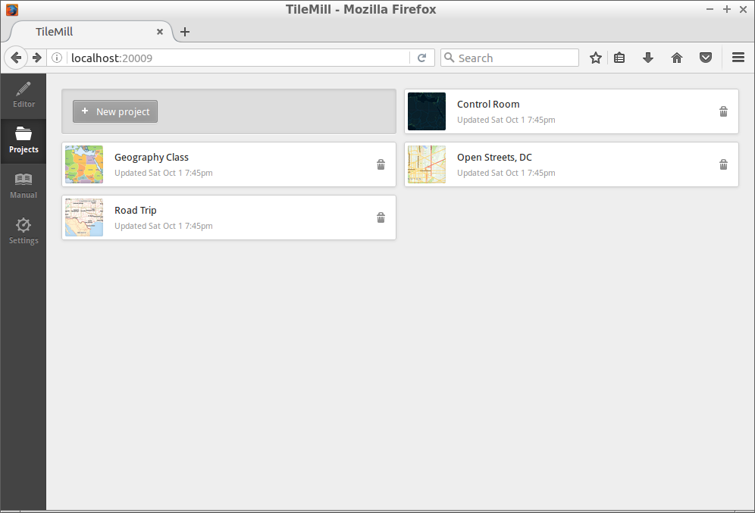
Tileoven in web browser

Slide 33
mapnik
Open source mapping toolkit for map rendering.
OpenStreetMap use this software.
Tilemill can export mapnik xml from style.
http://mapnik.org/

Slide 34
Carto / CartoCSS
CSS-like stylesheet for map.
Tilemill style file (*.mss) is CartoCSS.
Tilemill project file (*.mml) will translate to mapnik xml and rendered using mapnik.
Tilemill project
carto
Mapnik xml
mapnik
map

Slide 35
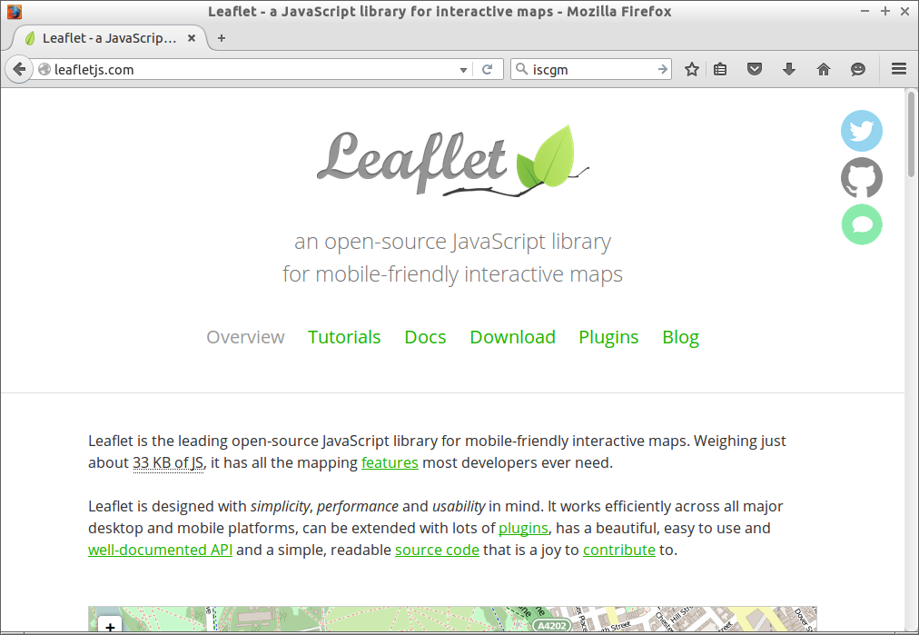
Leaflet.js
Open Source JavaScript Library for interactive map.
http://leafletjs.com/

Slide 36
Support files
https://github.com/smellman/creating_tiles_with_global_map_support_files
Support files for this workshop.
Click “Download ZIP” in this page.

Slide 37
Global Map
Digital geographic information
Provided by International Steering Committee for Global Mapping (ISCGM)
Composed of 8 Data Sets
Vector Data (Transportation, Boundaries, Drainage, Population Centres)
Raster Data (Elevation, Vegetation, Land Cover, Land Use)
Free for non-commercial use.

Slide 38
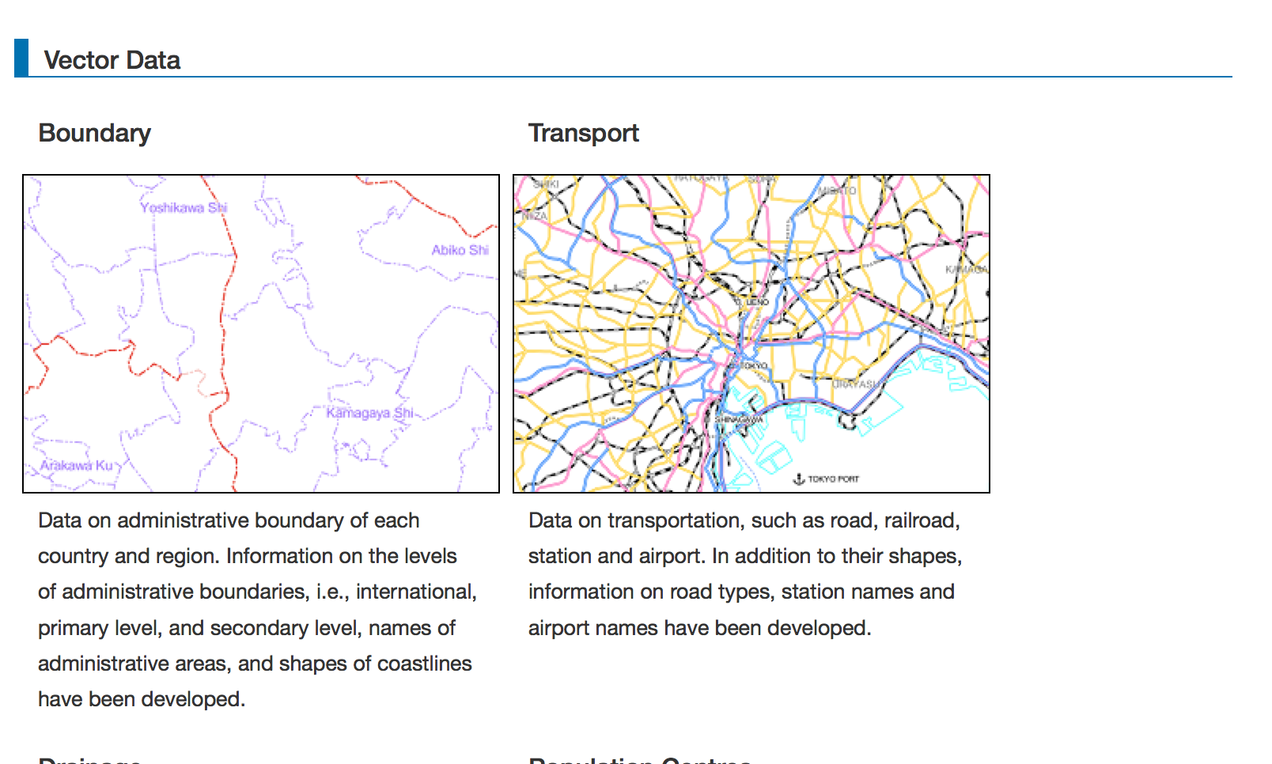
Examples
http://www.iscgm.org/gm/national.html

Slide 39
Formats
Vector data provide as Geography Markup Language (GML) format.
Also available ESRI Shape File format as friendly format.
Raster data provide as Band interleaved by line (BIL) format.
Also available Geotiff format as friendly format.

Slide 40
Specification
You can download specification for Global Map data set.
http://www.iscgm.org/gm/spec.html

Slide 41
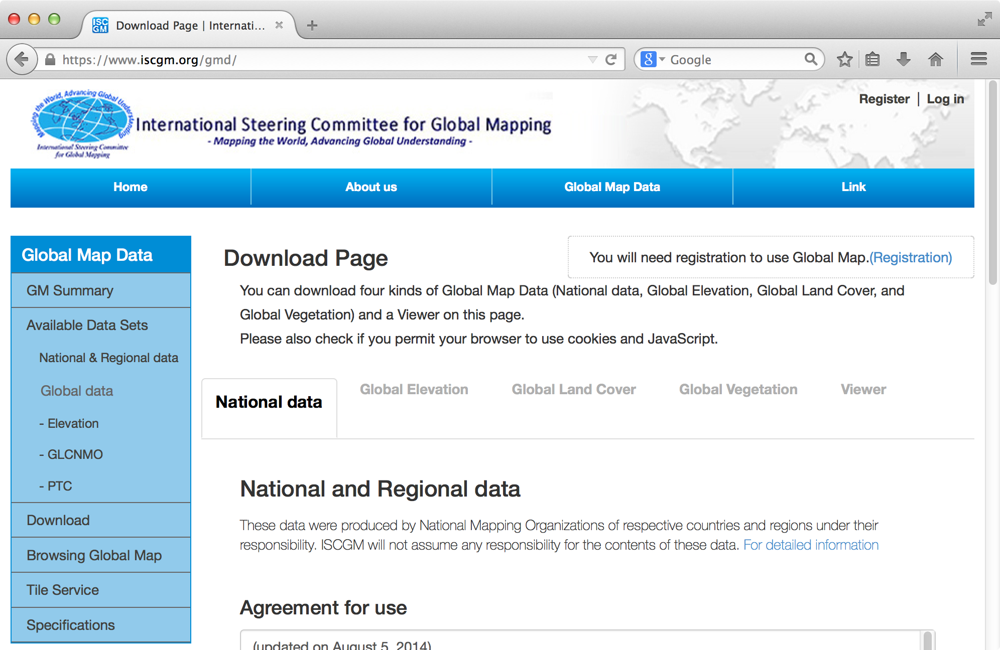
Download Global Map
https://www.iscgm.org/gmd/

Slide 42
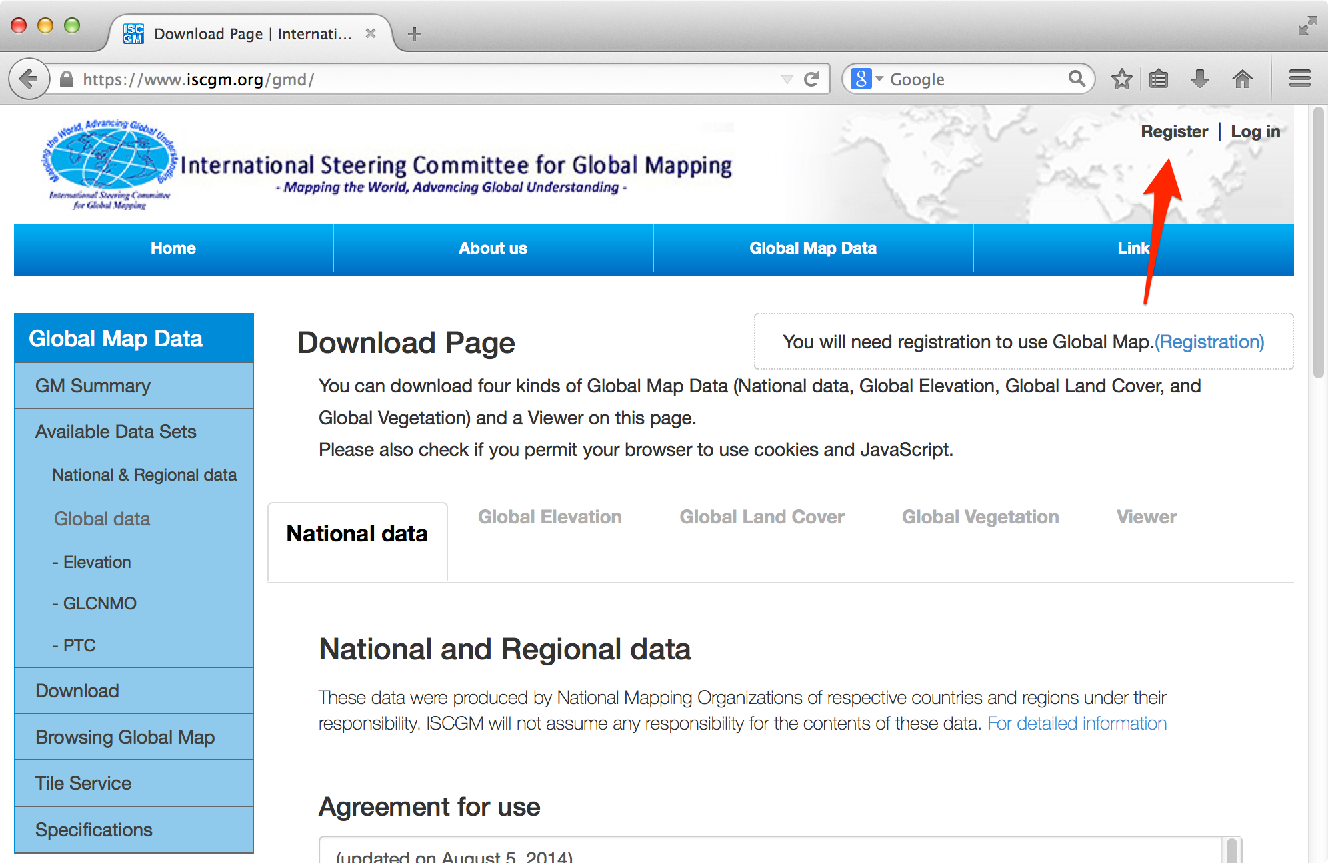
Access to Registration

Slide 43
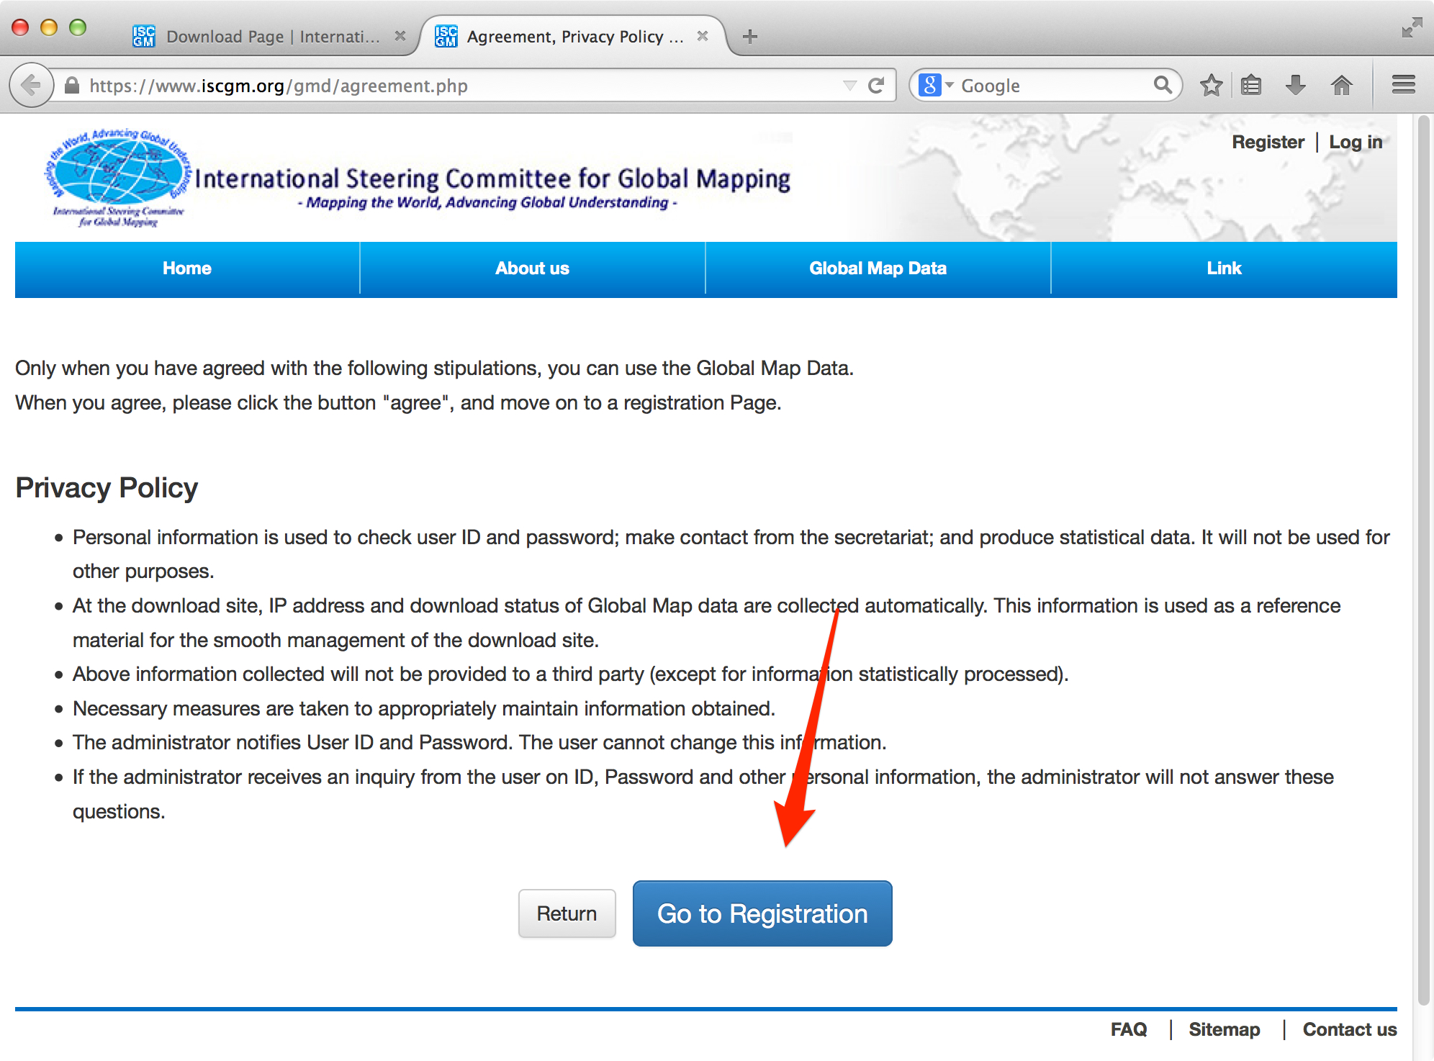
Go to Registration

Slide 44
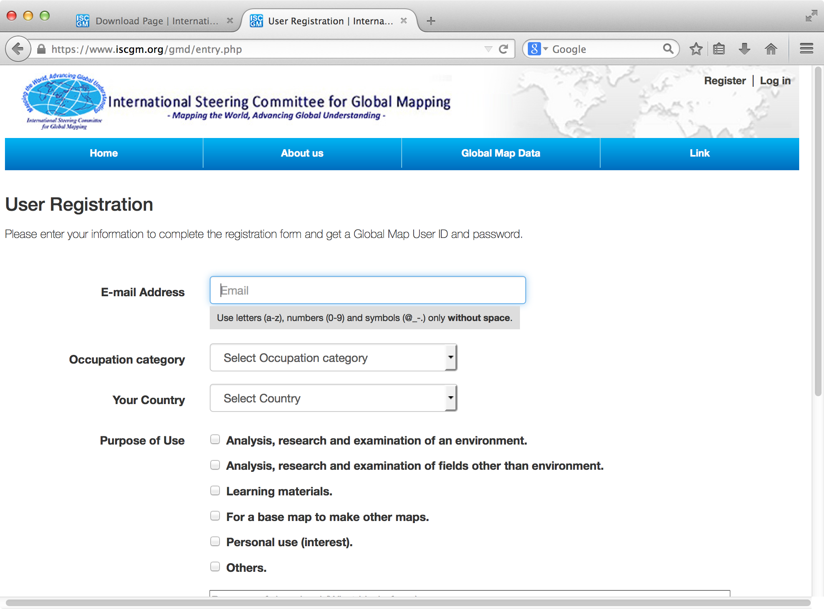
Enter your information and confirm

Slide 45
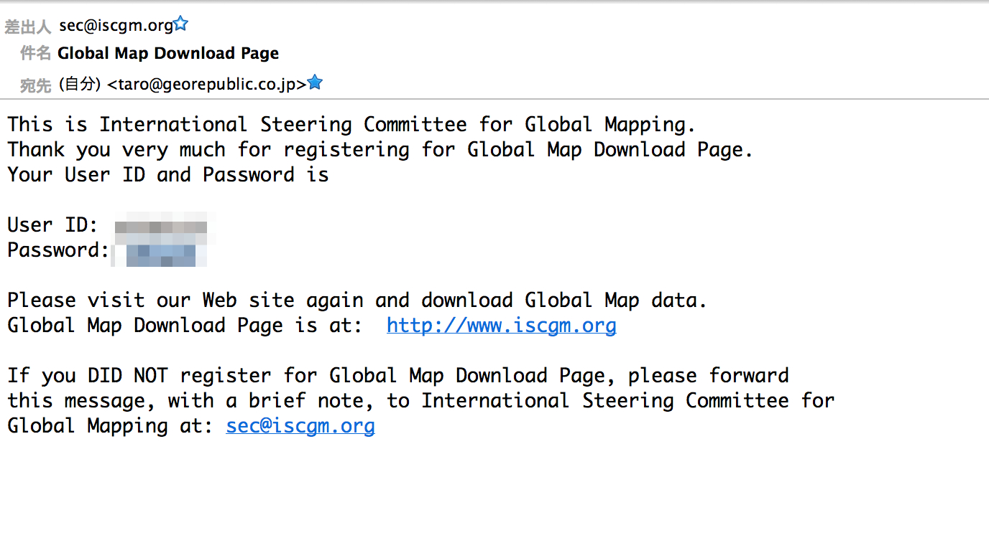
Receive ID and Password

Slide 46
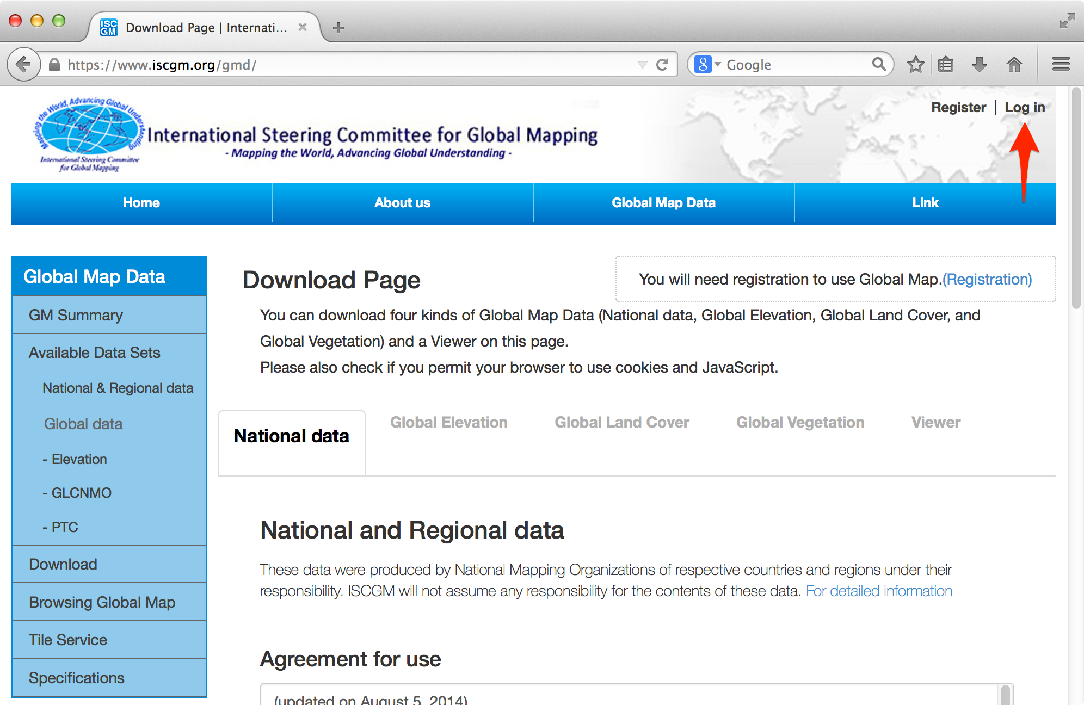
Login

Slide 47
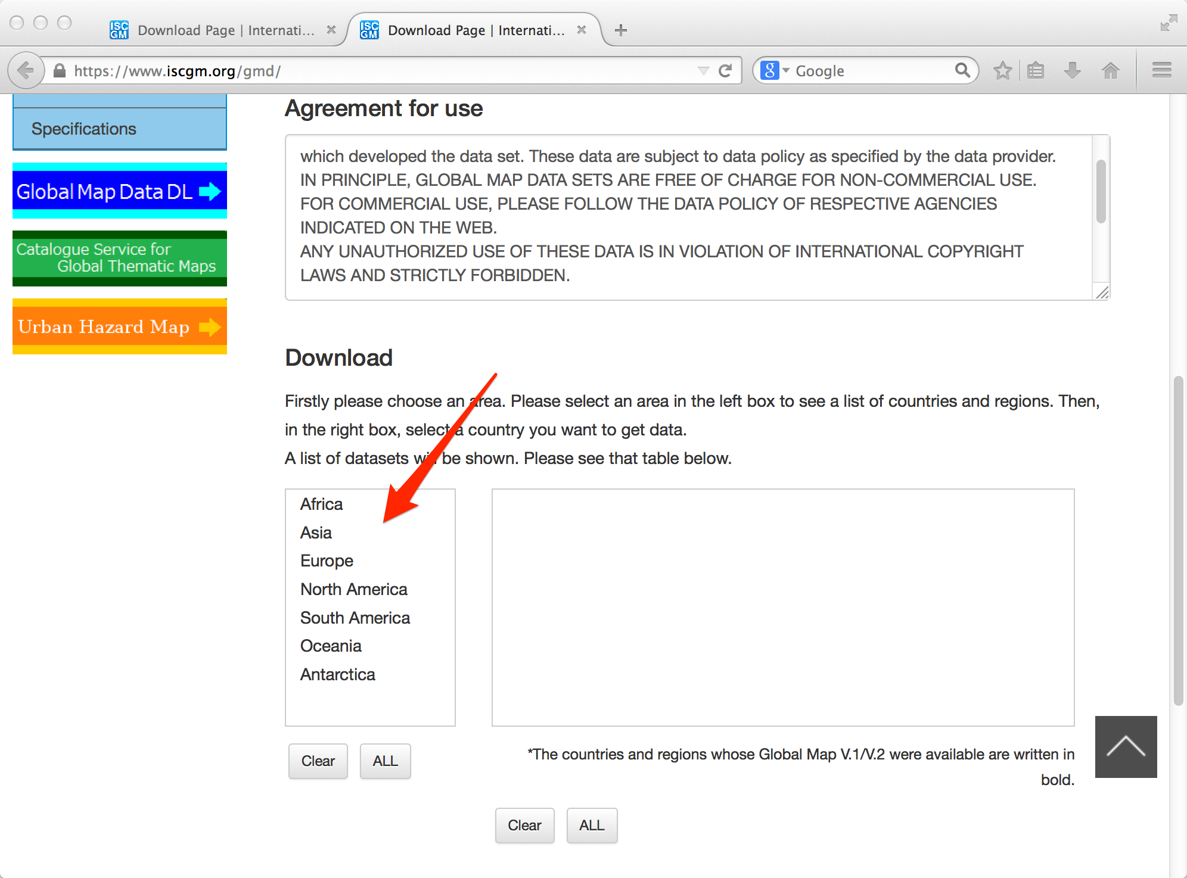
Select your area

Slide 48
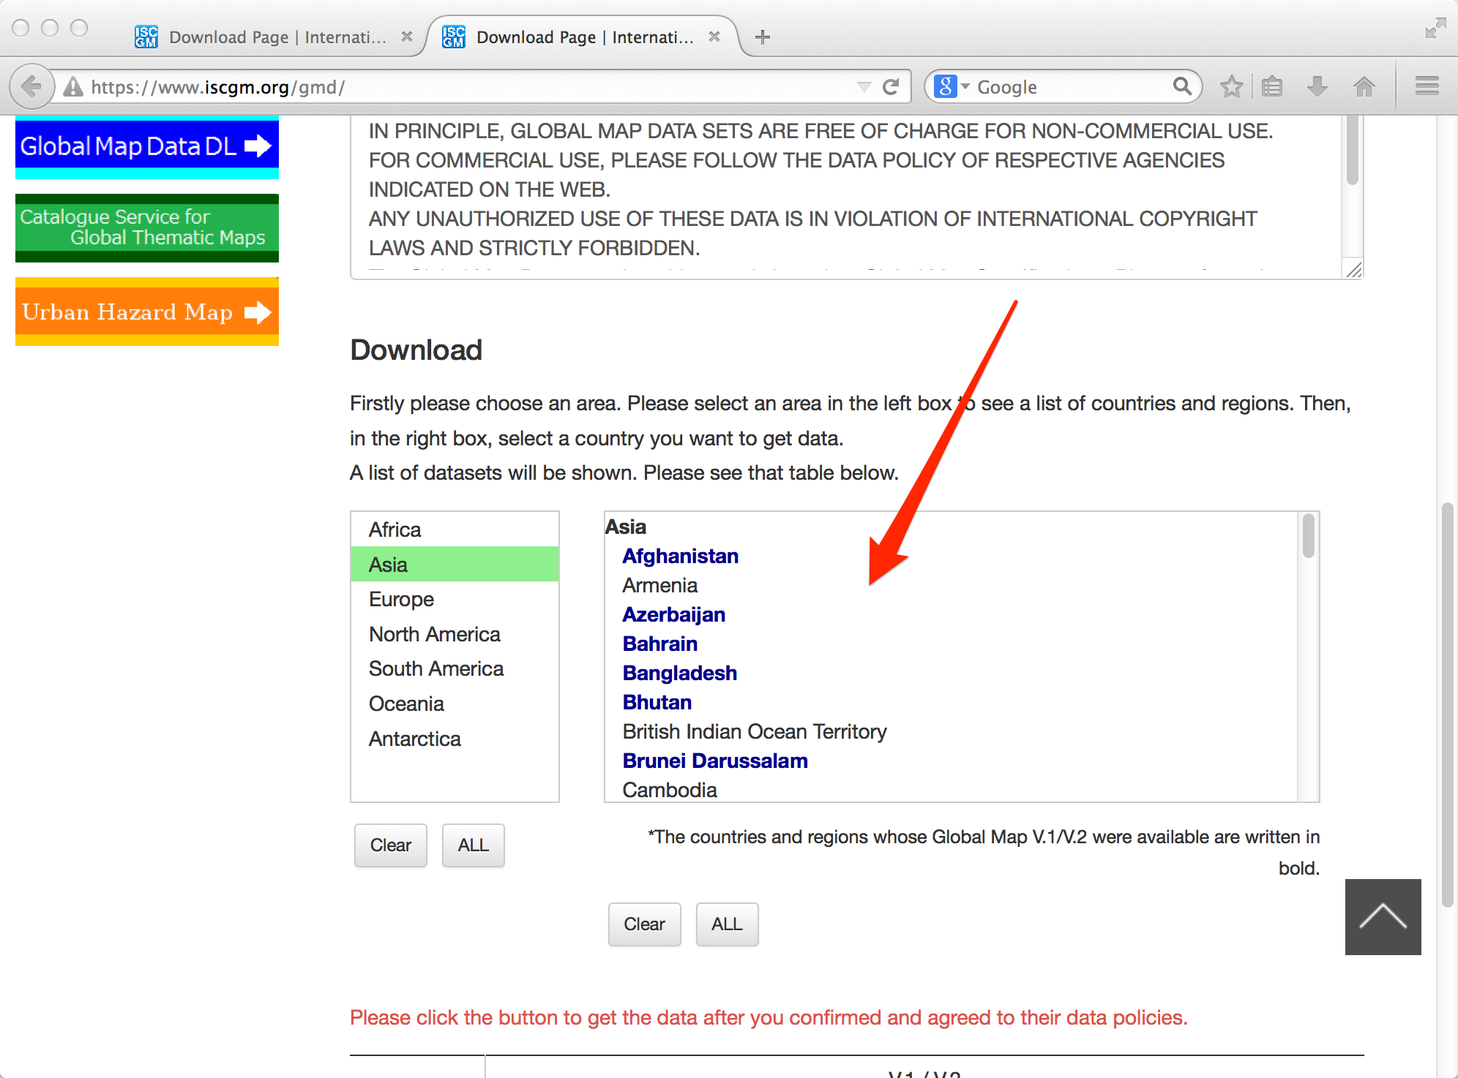
Select your country

Slide 49
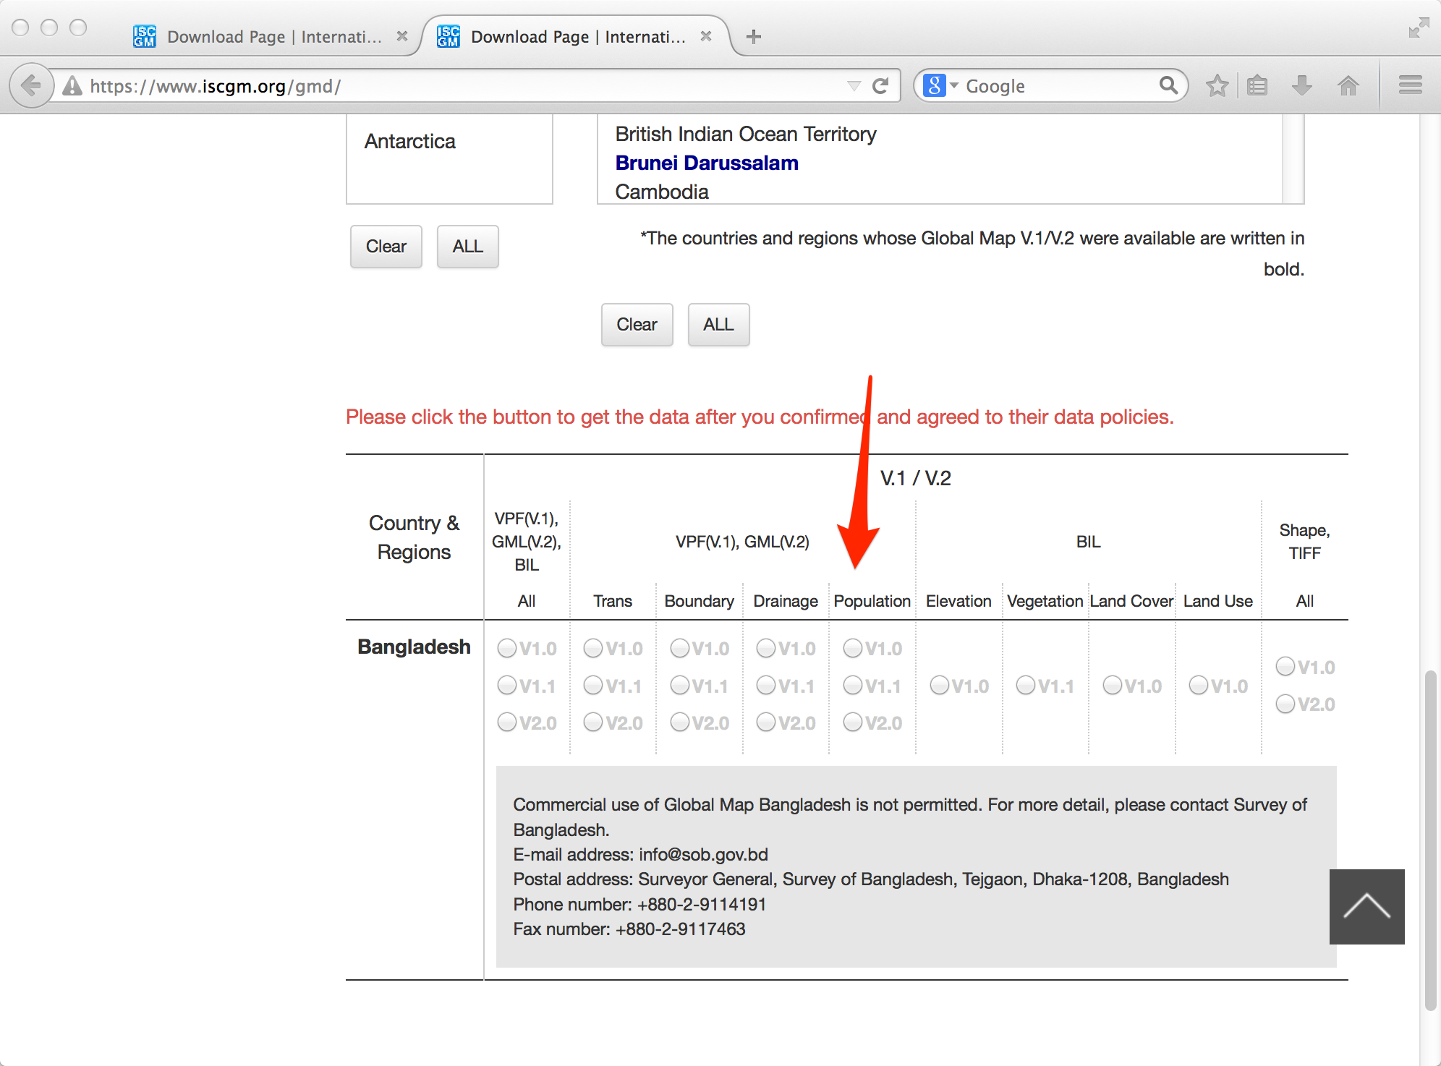
Select file

Slide 50
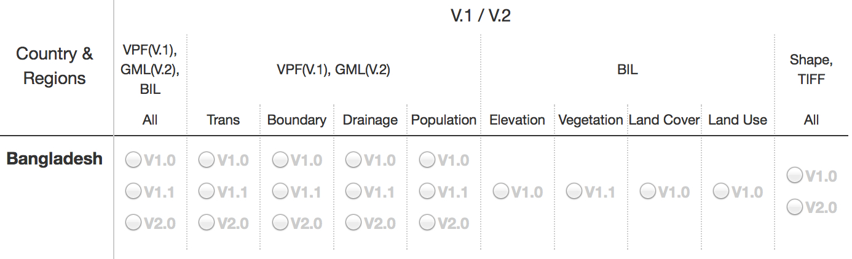
Notice
Shape file and TIFF file is contain only same versions.
In this case, V1.0 contains Shape and TIFF files but V2.0 contains only Shape file.

Slide 51
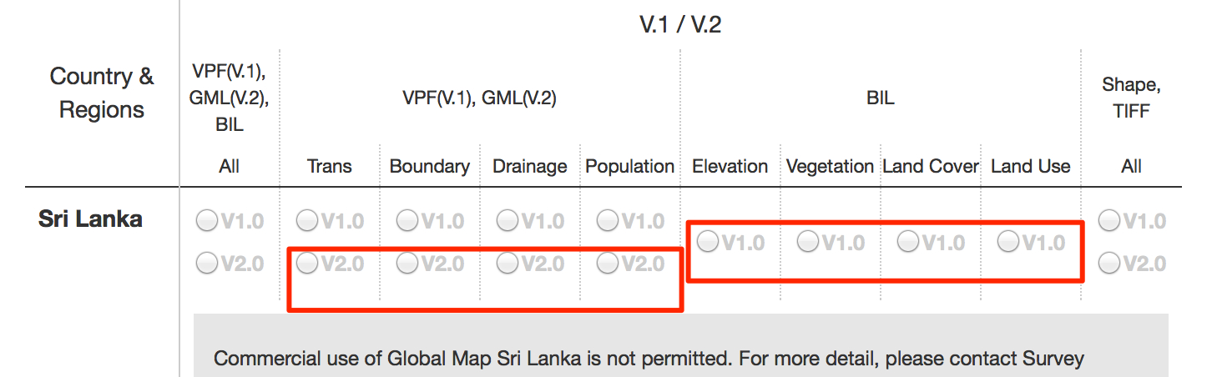
Download Sri Lanka data

Slide 52
If you can’t download data.
You can use github mirror.
https://github.com/globalmaps
This server uploads only User Friendly Data only.
BIL -> GeoTiff
GML -> ESRI Shapefile

Slide 53
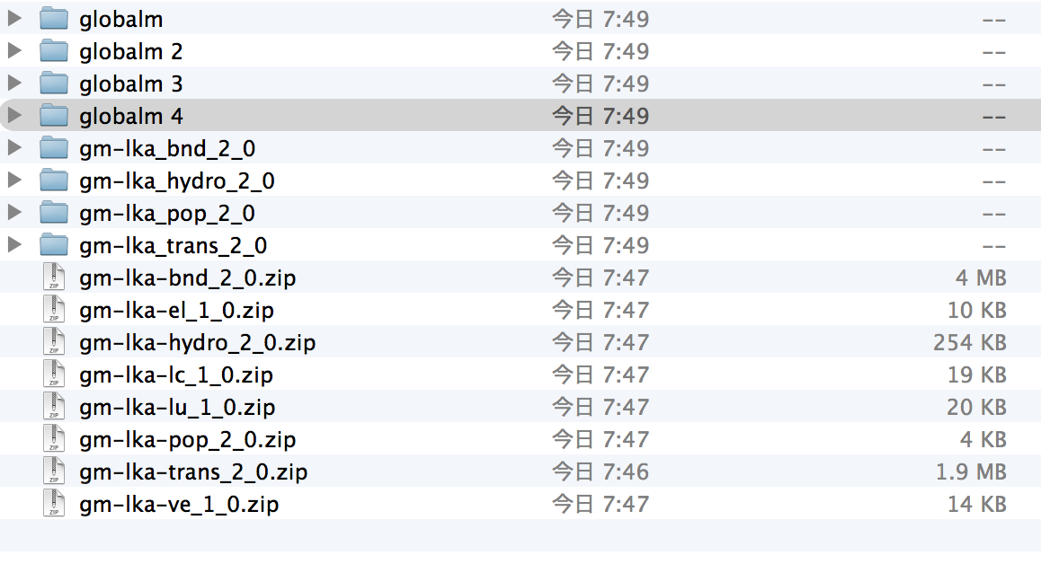
Unzip all but…
V1.0 Raster files are contain same name directory.

Slide 54
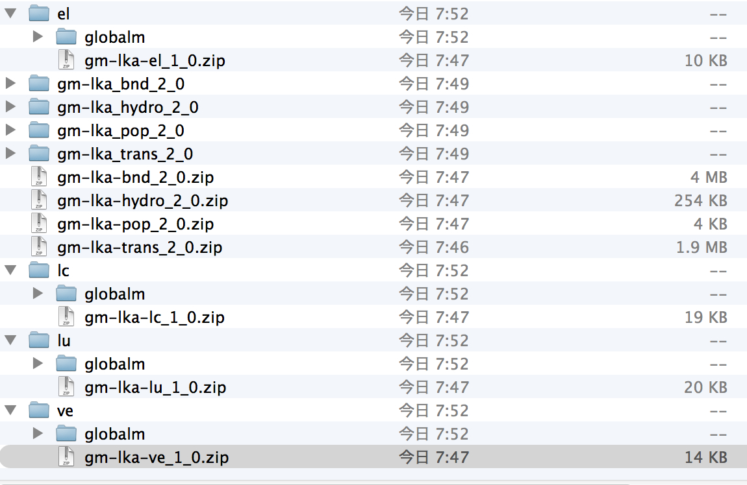
Make each directory and unzip

Slide 55
CREATE TILES FROM Vector FILES

Slide 56
Making 4 tiles from vector files
Boundary
Transport
Drainage
Population Centres

Slide 57
Workflow: Design map and generate tiled map from vector files
1. Convert GML to Shapefile
gml file
ogr2ogr
Shapefile
2. Design and generate mbtiles
Shape file
Shape file
Shapefile
Tilemill
mbtiles
3. Convert mbtiles to zxy tile
mbtiles
mbutil
png
png
png

Slide 58
Convert GML to Shape file
Use ogr2ogr command
You can use QGIS but set 2 crs before convert.
$ ogr2ogr -s_srs "+proj=latlong +datum=WGS84 +axis=neu +wktext" \
-t_srs "+proj=latlong +datum=WGS84 +axis=enu +wktext" \
-f "ESRI Shapefile" coastl_lka.shp coastl_lka.gml

Slide 59
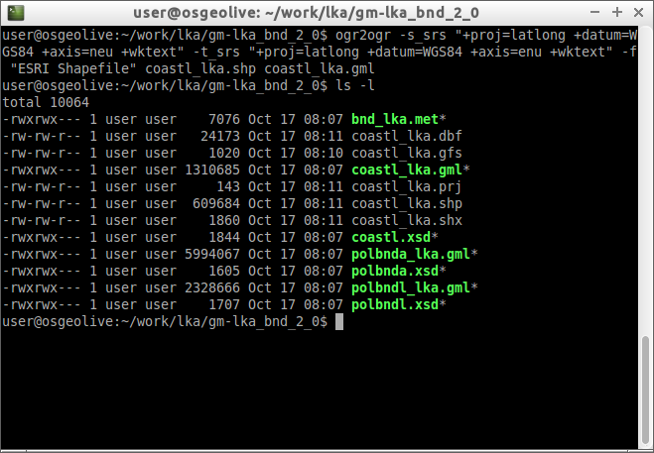
Convert GML to Shape file

Slide 60
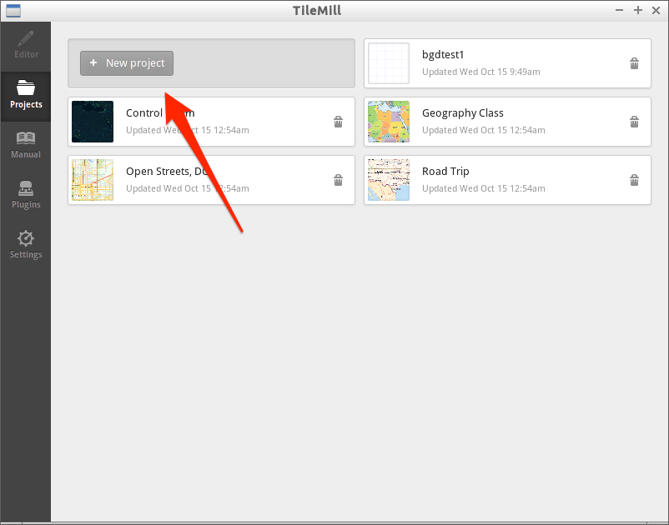
Launch Tilemill and create project

Slide 61
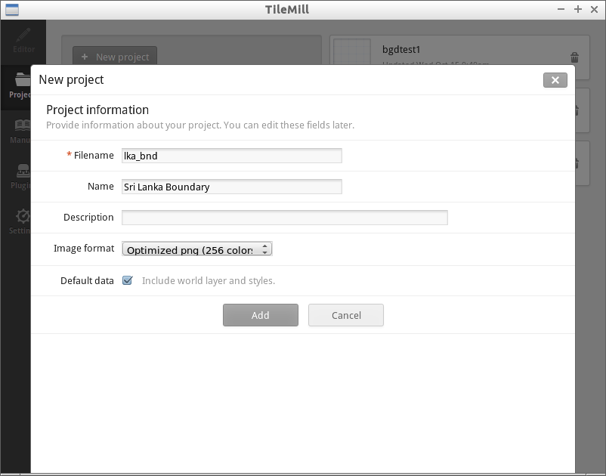
Input project names

Slide 62
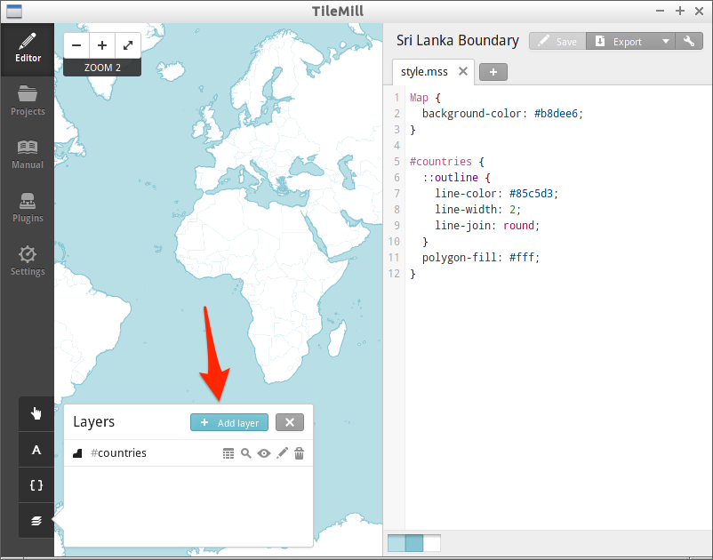
Open Layers and Add Layer

Slide 63
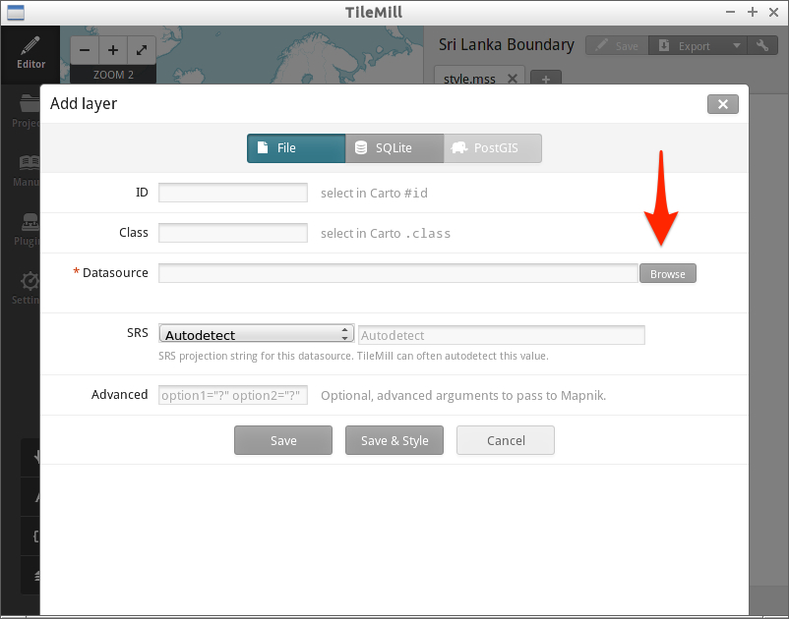
Select Datasource(Shape File)

Slide 64
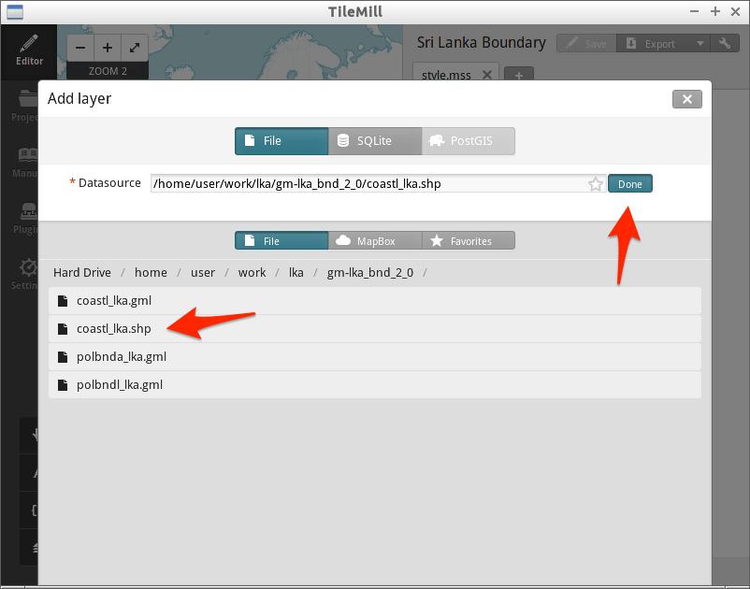
Select Datasource(Shape File)

Slide 65
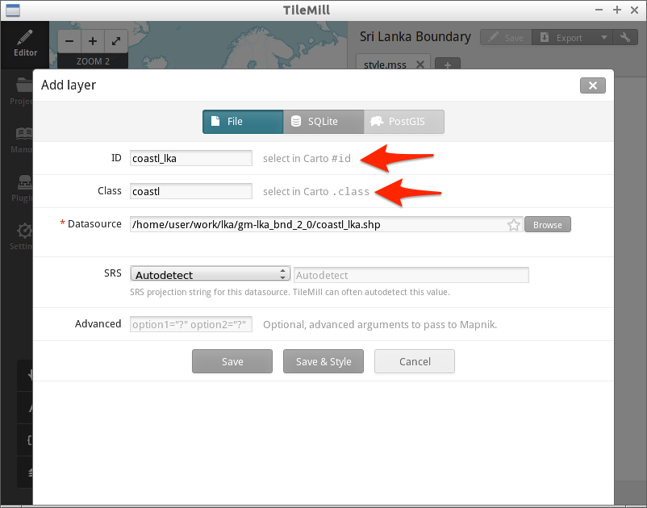
Enter ID and Class, and push Save Style

Slide 66
ID and Class
ID and Class are used in Carto CSS.
Like CSS
ID set datasource file name.
Class set datasource file name exclude country name.
ex. coastl_lka.shp
ID: coastl_lka
Class: coastl

Slide 67
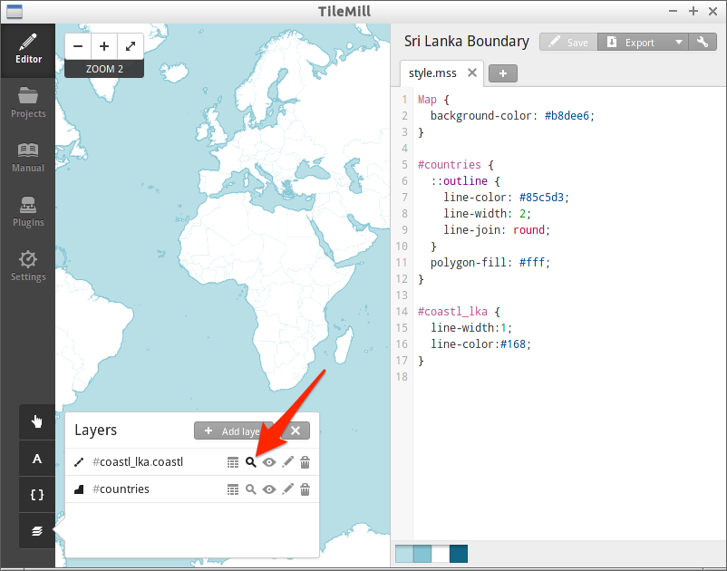
Zoom up to layer’s extent

Slide 68
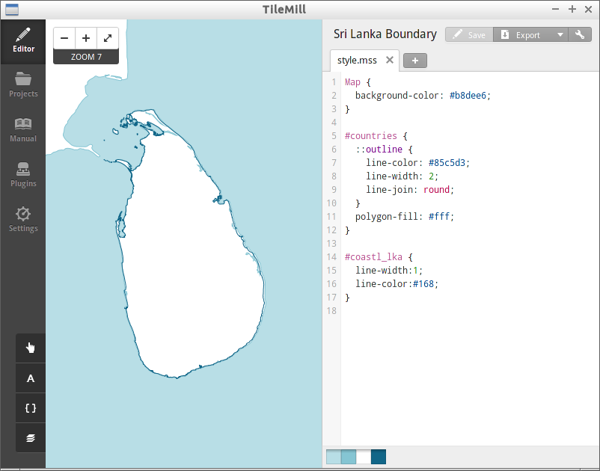

Slide 69
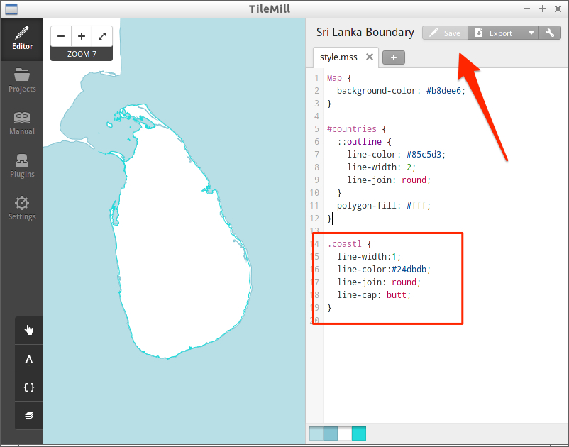
Change ID to Class and Edit Style

Slide 70
Import others
Convert polbnda_lka.gml and polbndl_lka.gml to shape files.
Import them into Tilemill.
Change styles.

Slide 71
Notice
All styles are available in support files and you can copy and paste from github.
https://github.com/smellman/creating_tiles_with_global_map_support_files/tree/master/2015/vector_cartocss
https://github.com/smellman/creating_tiles_with_global_map_support_files/tree/master/2015/raster_cartocss

Slide 72
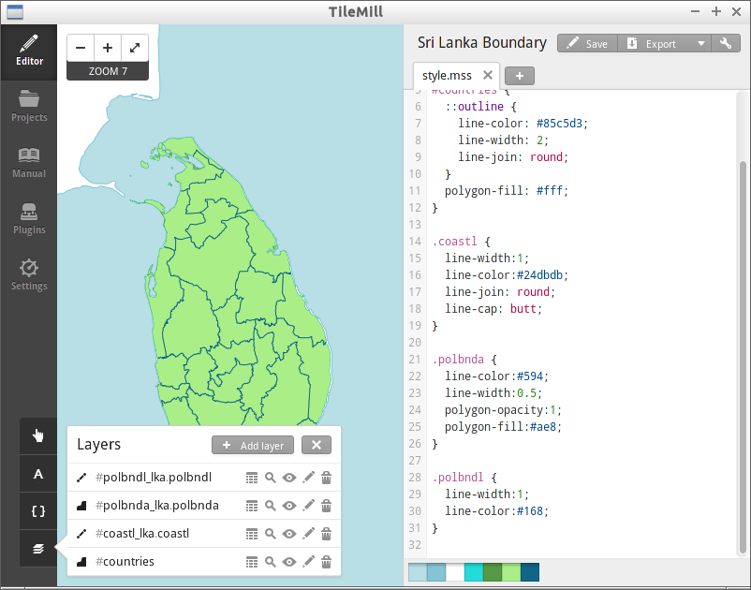

Slide 73
Add Text
Political Boundary Area (polbnda) include text.
Country code
State/Province/ Prefecture name
Local admistrative area name
Population (Number)
You can show text on map using text-name property.

Slide 74
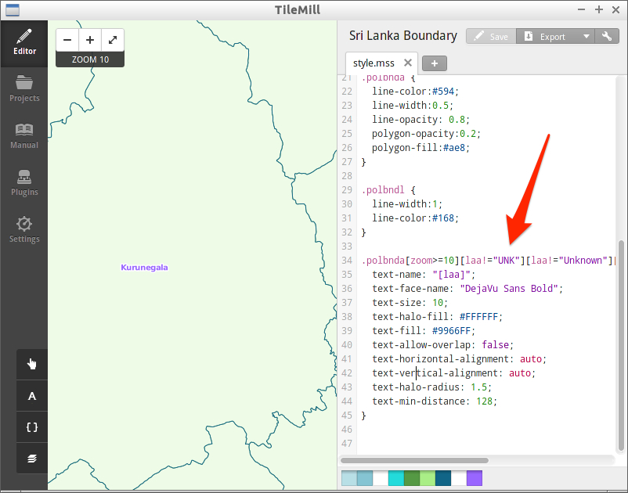
Add Text

Slide 75
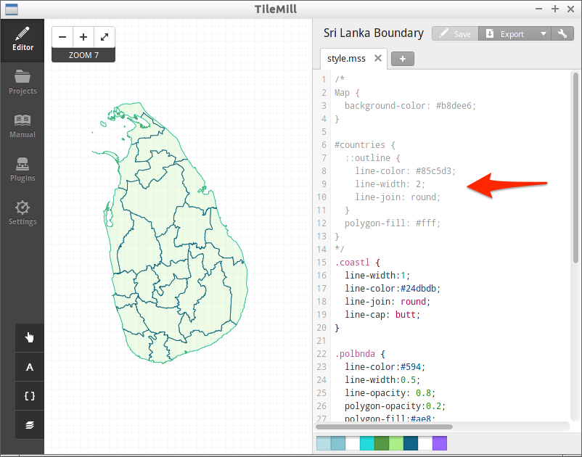
Remove Map and countries style

Slide 76
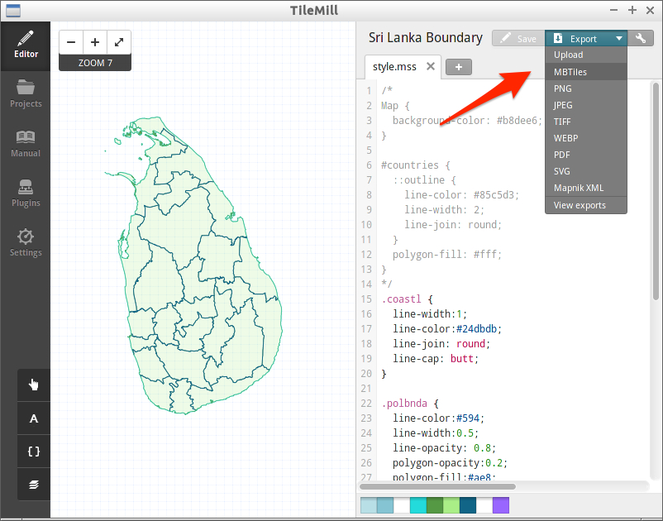
Export MBTiles

Slide 77
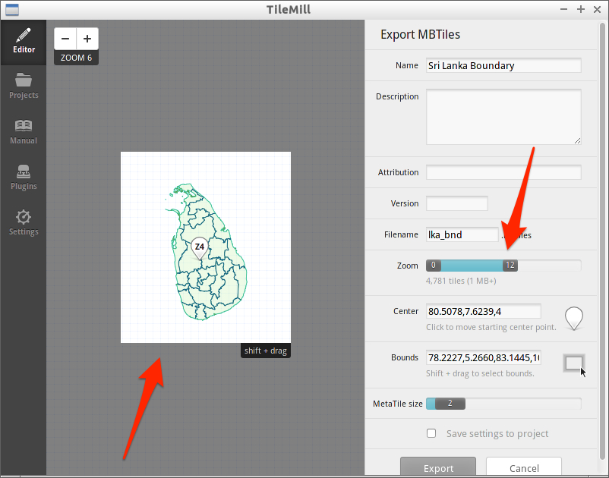
Change extent and zoom level range

Slide 78
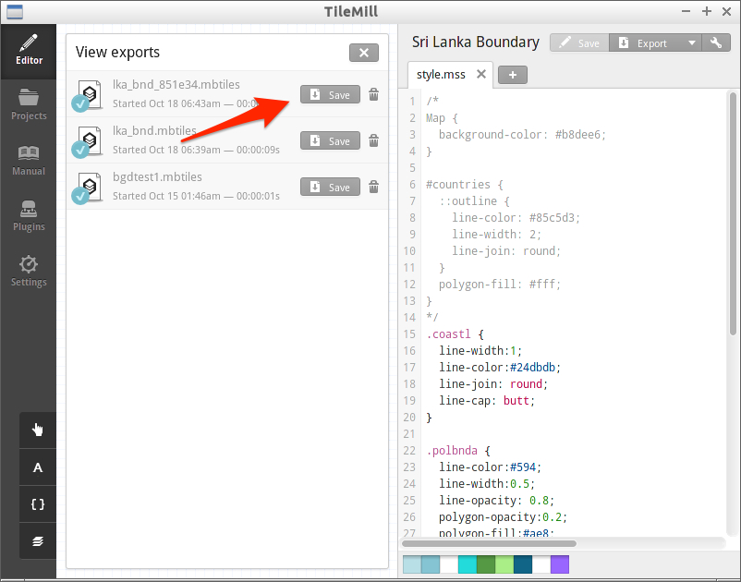
Save mbtiles file

Slide 79
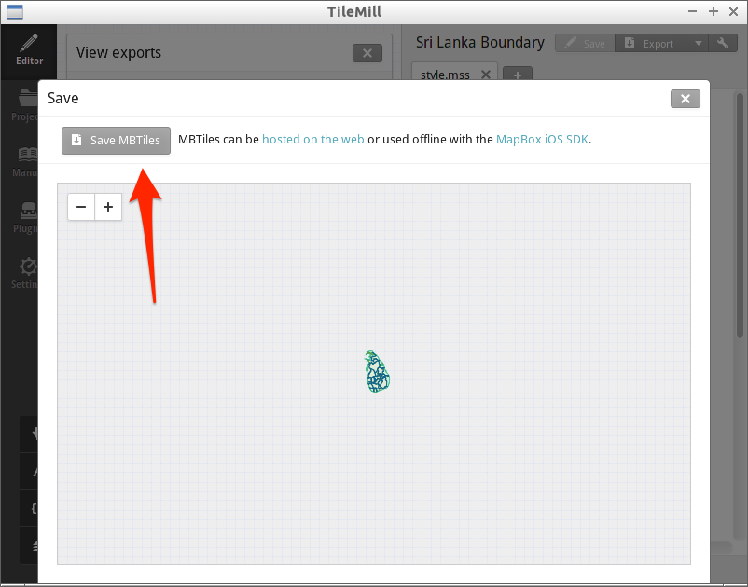
Save mbtiles file

Slide 80
Install mbutil
mbutil is utility for mbtiles.
https://github.com/mapbox/mbutil
Install to Linux
﻿$ git clone https://github.com/mapbox/mbutil.git
﻿$ cd mbutil/
﻿$ sudo python setup.py install

Slide 81
Install mbutil (for OSGeo4W)
Download ZIP in mbutil web page.
Unzip it.
“cd” to Unzipped directory and
python setup.py install
Copy “mb-util.bat” from support file to C:\OSGeo4W\bin

Slide 82
Convert mbtiles to xyz tiles
Usage:
mb-util <MBTiles path> <output path>
$ cd ~/work/lka
$ mkdir tiles
﻿$ mb-util mbtiles/lka_bnd.mbtiles tiles/lka_bnd

Slide 83
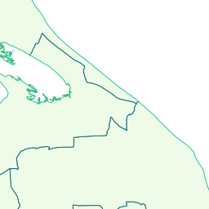
Generated file
﻿work/lka/tiles/lka_bnd/9/370/242.png

Slide 84
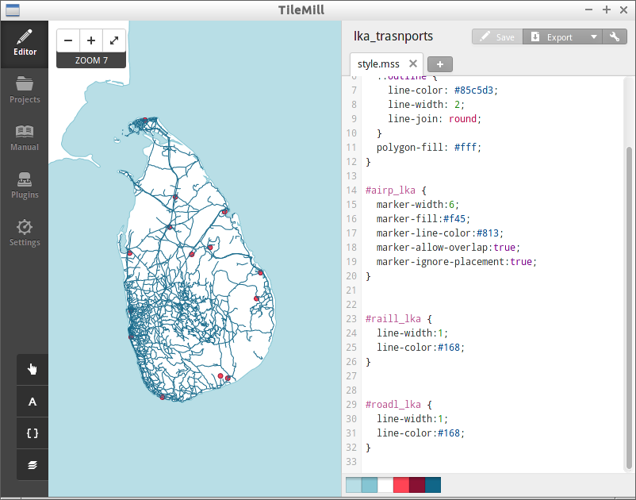
Transports
Convert airp, raill and roadl gml files to Shape files and import to Tilemill.

Slide 85
Point
airp(Airport) is Point.
Points enable to put icon images.
You can design icon but normally search icon images in internet.
Maki
A clean point of interest icon set from MapBox
https://www.mapbox.com/maki-icons/

Slide 86
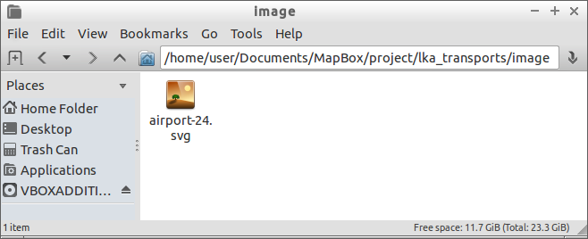
Import image to Tilemill Project
Open your tilemill project directory
Windows: (Home Directory)\My Documents\MapBox\project\(project file name)
Linux: (Home Directory)/Documents/MapBox/project/(project file name)
Make image directory and copy file.

Slide 87
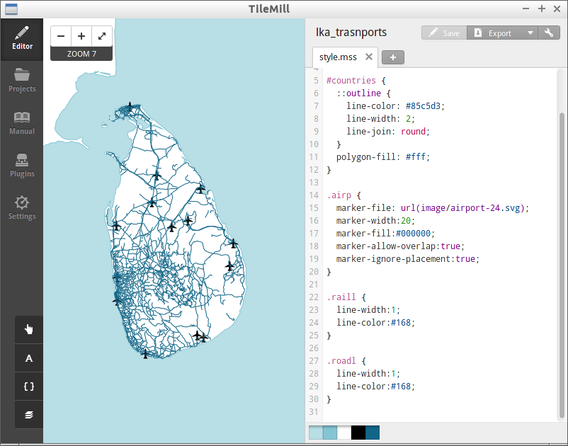
Set image
Add marker-file properties to airp class.
marker-file use url() function.
https://developer.mozilla.org/en-US/docs/Web/CSS/uri
marker-file:
url(image/airport-24.svg);

Slide 88
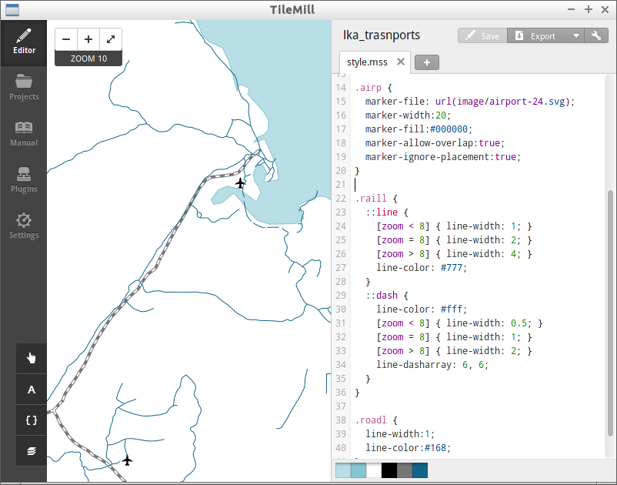
Styling rail way
https://tilemill-project.github.io/tilemill/docs/guides/styling-lines/#railroads
Use line-dasharray
line-dasharray: 6, 6;

Slide 89
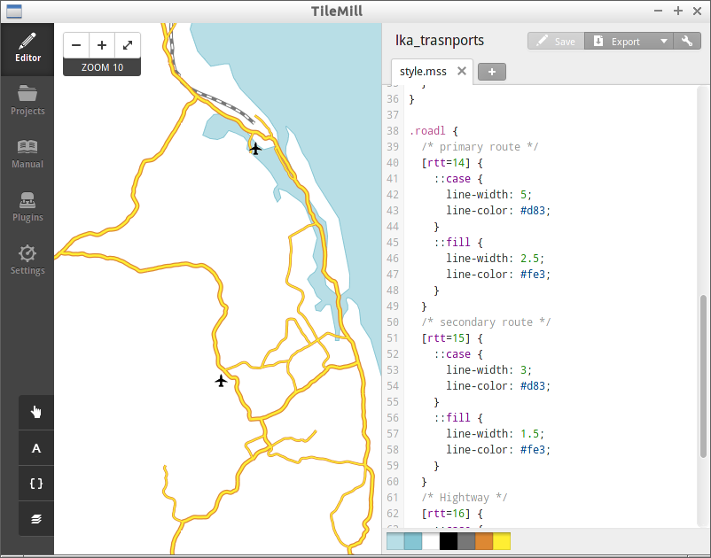
Styling roads
https://tilemill-project.github.io/tilemill/docs/guides/styling-lines/#roads

Slide 90
Generate tiles
Comment out Map and countries styles.
Export to mbtiles
Convert tiles from mbtiles

Slide 91
CREATE TILES FROM RASTER FILES

Slide 92
Making 4 tiles from raster files
Elevation
Land Use
Land Cover
Vegetation

Slide 93
Workflow: Design map and generate tiled map from raster files
1. Create Virtual file from BIL
BIL file
gdalbuildvrt
Virtual file
2. Design and generate mbtiles
Virtual file
Tilemill
mbtiles
3. Convert mbtiles to zxy tile
mbtiles
mbutil
png
png
png

Slide 94
Raster files
Global maps raster files are distributed bil format.
Bil files are separated some regions.
Create one virtual file from separated bil files.
Each pixels contain value.
Elevation: Elevation above mean sea level (meter).
Vegetation: Percent tree cover.
Others: classification value (See specification).

Slide 95

Land Use example
Global Map Specifications Version 2.2 - APPENDIX D Global Map Data Dictionary
http://www.iscgm.org/gm/spec/gmspec-2.2.pdf

Slide 96
Create elevation tiles
Create one virtual file from bil files (el/globalm/area/raster/el*.bil)
Design using Tilemill and export mbtiles
Convert mbtiles to zxy tiles

Slide 97
Create Virtual file from bil files
Create a virtual file from bil files using “gdalbuildvrt” command.
﻿$ gdalbuildvrt --config GDAL_CACHEMAX 2048 \
el_lka.vrt el/globalm/area/raster/el*.bil

Slide 98
Open with Tilemill
Select datasource (*.vrt) and input ID and class.
Choose “WGS84” in SRS.
Input ‘band=“1”’ in Advanced text field.
Push “Save & Style”

Slide 99

Open with Tilemill

Slide 100

Error on Linux
If tilemill raise this error, you need install “mapnik-input-plugin-gdal” package.
$ sudo apt-get install \
mapnik-input-plugin-gdal

Slide 101


Slide 102

Add style

Slide 103
Raster style
raster-scaling: scaling algorithm
raster-colorize-default-mode:
“liner”: Elevation
“exact”: Land use, Land Cover, Vegetation
raster-colorize-stops: pair value and color
stop(value, color)
stop(15, #5CCE4E): value 15, color #5CCE4E
See mapnik document
https://github.com/mapnik/mapnik/wiki/RasterColorizer

Slide 104
creating Simple map

Slide 105
Download leaflet.js
﻿http://leafletjs.com/download.html
Download Leaflet 0.7.3
Make $HOME/work/leaflet directory and copy leaflet-0.7.3.zip
Unzip leaflet-0.7.3.zip

Slide 106

Copy html file
Copy lka.html in support files to $HOME/work

Slide 107

Open with browser

Slide 108

Select Layers

Slide 109

Boundary Layer

Slide 110

Zoom up

Slide 111

Transports Layer

Slide 112

Elevation Layer

Slide 113
Code
<!DOCTYPE html>
<html>
<head>
<meta charset="UTF-8">
<title>Sri Lanka Map</title>
<link rel="stylesheet" href="./leaflet/leaflet.css" />
<script src="./leaflet/leaflet.js"></script>
<style>
body {padding: 0; margin: 0}
html, body, #map {height: 100%; width: 100%;}
.leaflet-container {background: #fff;}
</style>
</head>

Slide 114
Code
<body>
<div id="map">
<script>
var basemap = L.tileLayer('http://{s}.tile.openstreetmap.org/{z}/{x}/{y}.png', {
attribution: "© OpenStreetMap contributors"
});
var map = L.map('map', {
center: [7.7110,80.5078],
zoom: 7,
layers: [basemap]
});
var base_layers = {
"OpenStreetMap": basemap
};

Slide 115
Code
var bnd_layer = L.tileLayer('./lka/tiles/lka_bnd/{z}/{x}/{y}.png');
var transports_layer = L.tileLayer('./lka/tiles/lka_transports/{z}/{x}/{y}.png');
var elevation_layer = L.tileLayer('./lka/tiles/el_lka/{z}/{x}/{y}.png');
var overlay_layers = {
"Boundary": bnd_layer,
"Transports": transports_layer,
"Elevation": elevation_layer
};
L.control.layers(base_layers, overlay_layers).addTo(map);
</script>
</body>
</html>

Slide 116
Vector Tiles and others

Slide 117
Tile without “raster image”
Tile can provide without “raster image”.
{z}/{x}/{y}.{format}
You can use many formats.
Text data, GeoJSON/TopoJSON data, other binary data

Slide 118

UTFGrid
UTFGrid provides rasterized interaction data.
Map data looks like an ASCII art.

Slide 119
GSI’s DEM tile
10m mesh data.
Provides only japan area.
http://cyberjapandata.gsi.go.jp/xyz/dem/{z}/{x}/{y}.txt

Slide 120
quantized-mesh
Terrain tileset using Cesium.
Using TMS schema and global-geodetic profile.
http://cesiumjs.org/data-and-assets/terrain/formats/quantized-mesh-1.0.html
AGI provide only commercial application to generate it, but Swiss Geoportal develop new program.
https://github.com/geoadmin/3d-forge

Slide 121

Cesium 3D Tiles
AGI develop new specification for Cesium.
https://cesiumjs.org/2015/08/10/Introducing-3D-Tiles/

Slide 122

GeoJSON Tiles
Provide GeoJSON file with zxy tile.
GSI provide experimental demo.
http://gsi-cyberjapan.github.io/experimental_fgd/

Slide 123
Mapbox Vector Tile
Mapbox develop vector tile specification.
Vector tile provide using Protocol Buffers.
Smaller than GeoJSON file
Provide too many layers.
Mapbox GL Style define rendering layers and styles.

Slide 124
Mapbox Vector Tile demo
Supporting file for this workshop includes Mapbox Vector Tile demo.
2015/mapbox_vector_tile_demo directory
tilelive-bridge is support to generate mapbox vector tile from mapnik xml.

Slide 125
Supplementary note

Slide 126
File system limit
When you create map covered world, be careful about max number of files.
Ext4 on Linux: 4 billion files (specified at filesystem creation time)
Zoom Level 18 on world: 68 billion files.
Also be careful about file usage.

Slide 127
Rendering server
Too many rendering server use mapnik.
mod_tile: Renders and serves map tiles using Apache.
https://github.com/openstreetmap/mod_tile
TileStache: Python-based server application.
http://tilestache.org/
If you need to serve too many tiles, using rendering server is better than using static tiles.
Tilemill can export mapnik xml, this mean you can use Tilemill in the design phase and use mapnik with rendering server.

